Slide 1

LVIV POLYTECHNIC NATIONAL UNIVERSITY
Computer Science
Exploring the foundation of modern computing architecture and software engineering.
Herasymenko Vadym KNIK-11

Slide 2



THE CORE FOUNDATION
Beyond Just Writing Code
Algorithmic Logic
System Architecture
Scalable Engineering
Mastering complex data structures.
Understanding hardware-software bridges.
Building robust, real-world applications.

Slide 3
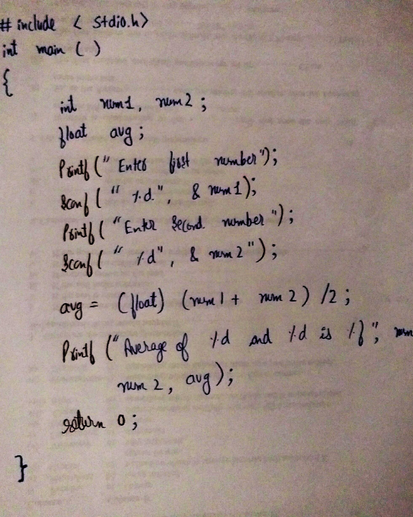
Programming on Paper
Mental Compilation: Executing logic without an IDE.
Pure Focus: Writing flawless syntax under exam pressure.
"Huge thanks to Zoreslava Yaroslavivna Shpak for this unforgettable, foundational experience."

Slide 4
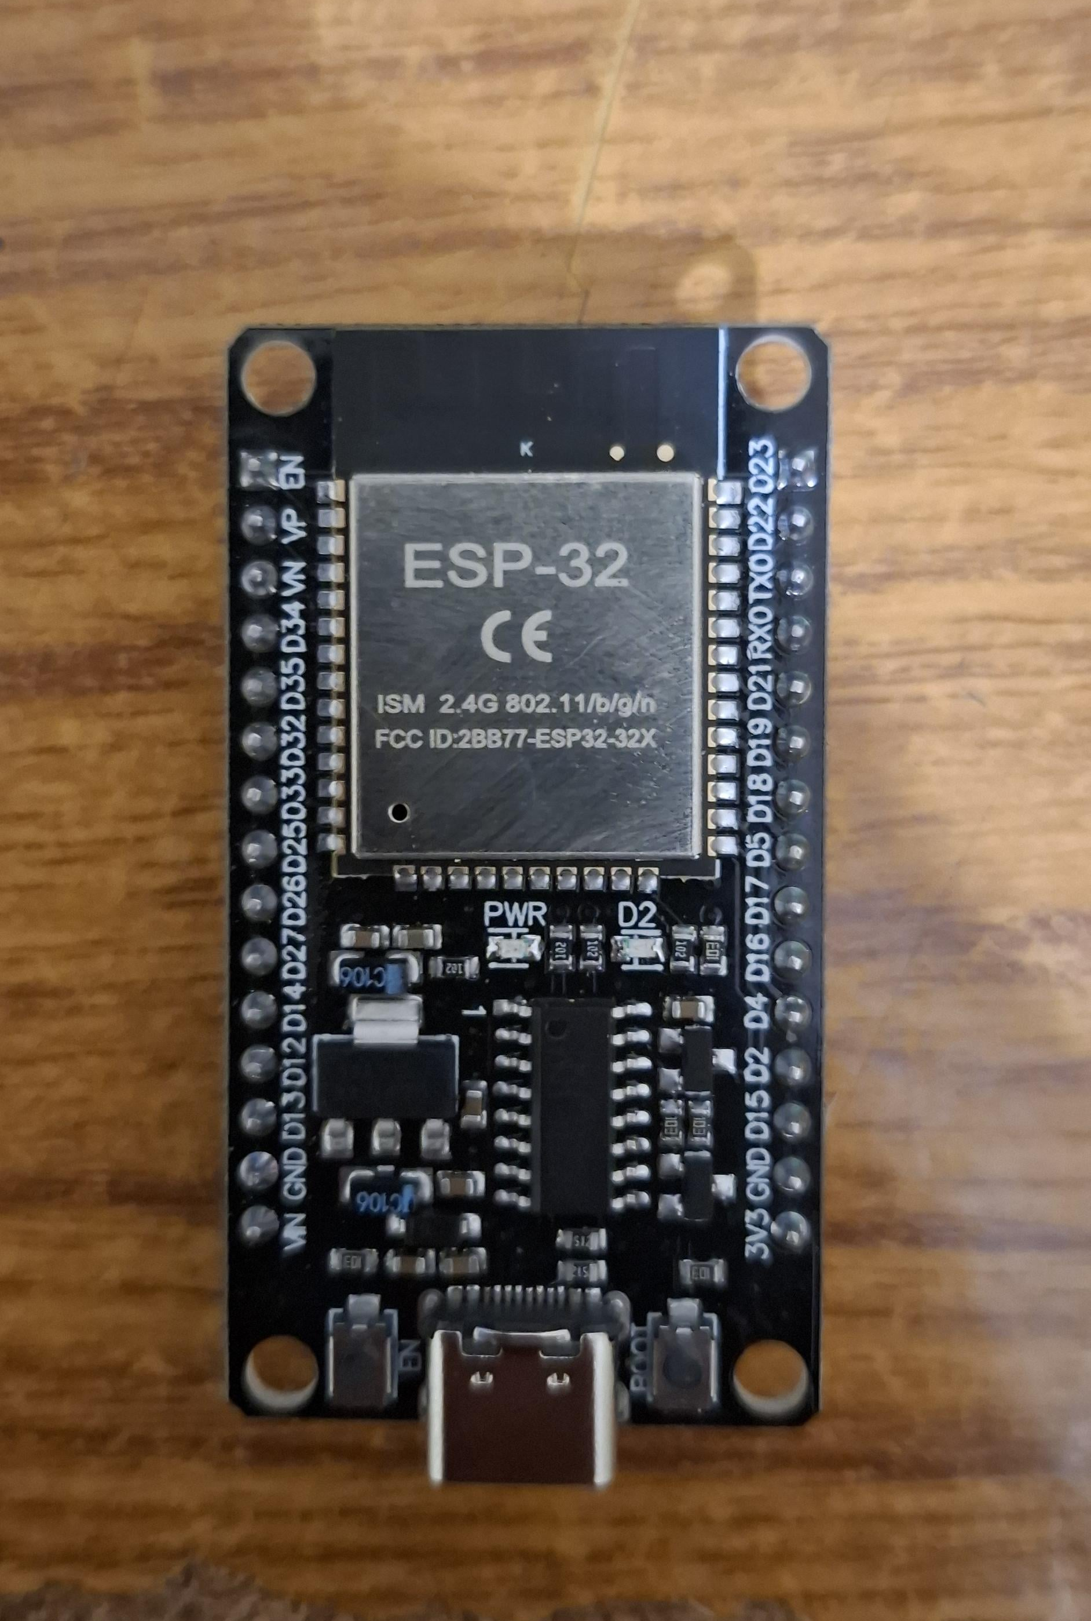
Bringing Code to Life
Embedded C/C++: Programming physical ESP32 microcontrollers.
Internet of Things: Connecting sensors to the web.
Instant Feedback: Controlling the physical world directly.

Slide 5
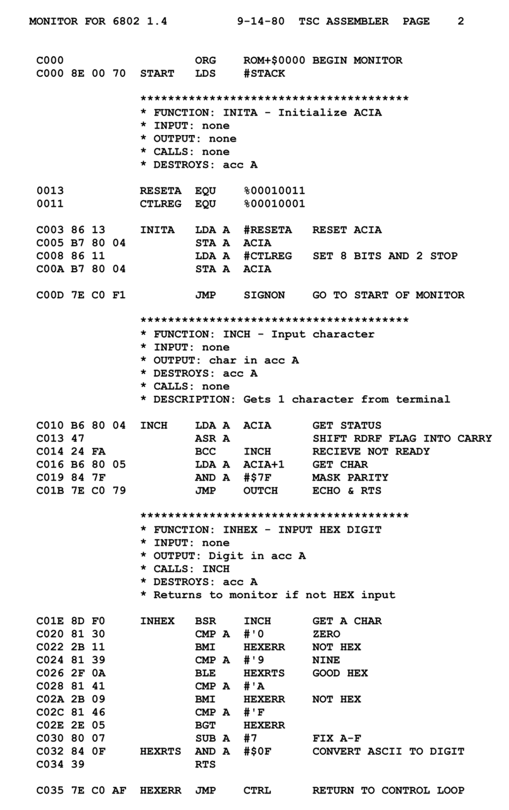
Learning Assembly
MOV AX, 0x0001
ADD AX, BX
; Unforgettable emotions
Low-Level Access: Direct CPU register manipulation.
Bypassing Abstractions: Understanding how memory truly works.

Slide 6



Where Does This Lead?
Software Engineer
Embedded Developer
Systems Architect
Building high-level applications.
Programming IoT and hardware.
Designing complex IT infrastructures.

Slide 7

Thank You!

